Slide 1
Profiling Report — Automotive Defect Dataset
Ranjith_S

Slide 2
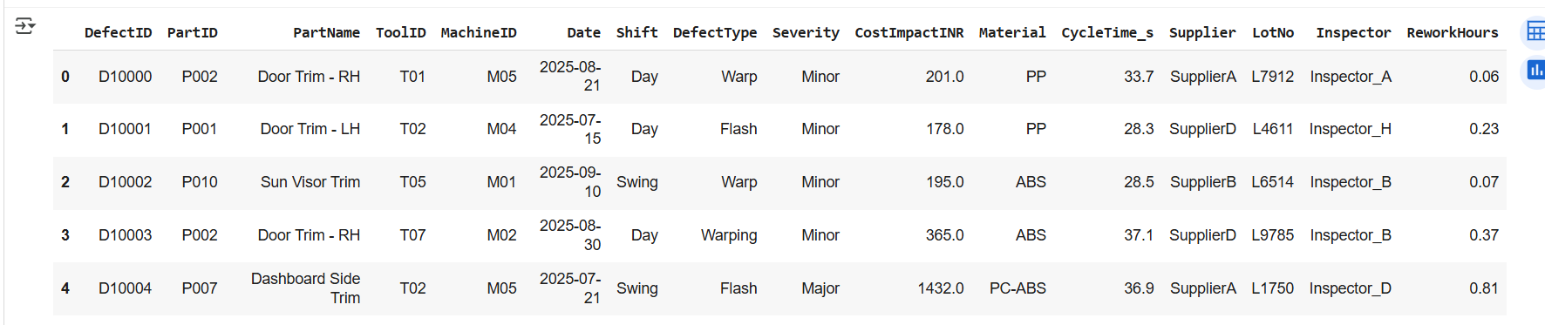

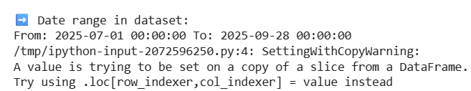
Dataset Overview
Total Rows = 510, Columns = 16.
Date Range = 2025-07-01 to 2025-09-28.
Dataset Purpose = Automotive defects log (part defects, costs, suppliers).

Slide 3
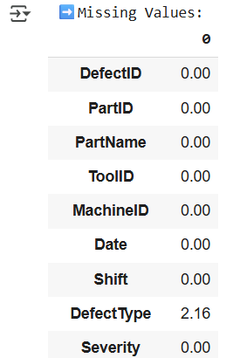
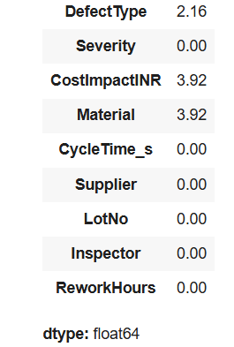
Missing Values
DefectType → 11 missing (2.1%) → Fill with mode.
CostImpactINR → 20 missing (3.9%) → Fill with median grouped by DefectType.
Material → 20 missing (3.9%) → Fill with mode.
✅ All other columns → No missing values.

Slide 4
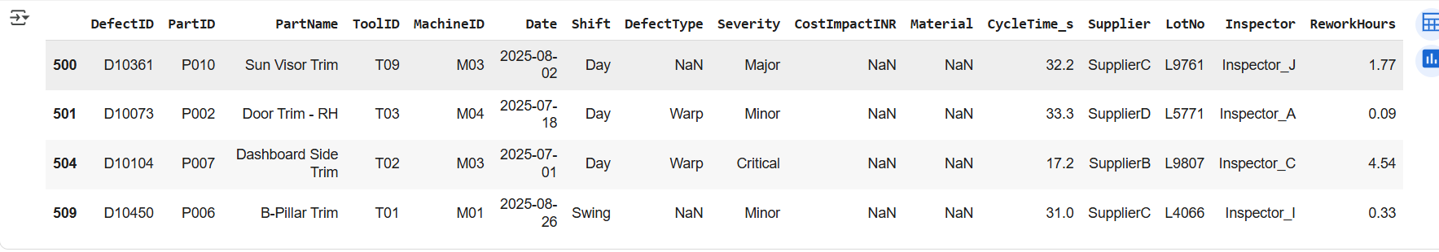
Duplicates
Found 4 exact duplicate rows → will drop.
No conflicting duplicates → no manual resolution needed.

Slide 5
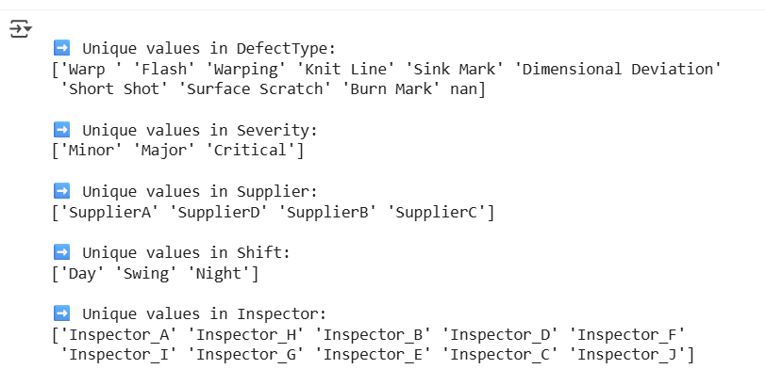
Category Quality
Issue: "Warp " (extra space) and "Warping".
✅ Action: Standardize to "Warp".
Supplier & Severity → clean (no typos).

Slide 6
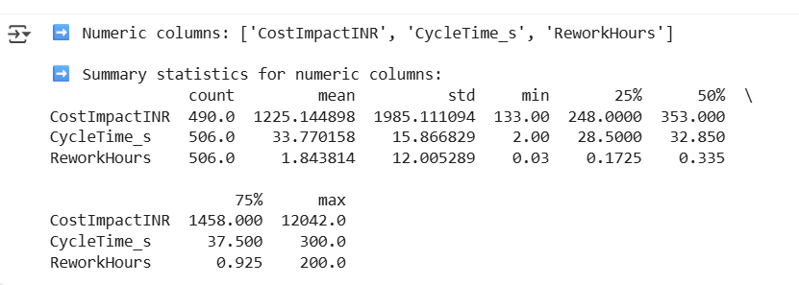
Numeric Summary
CostImpactINR: Median = ~255, Max = ~6000 → highly skewed.
CycleTime_s: Normal ~20–40 sec, outliers >200 sec → machine error cases.
ReworkHours: Median = 2 hrs, extreme values >20 hrs → long-tail rework.

Slide 7
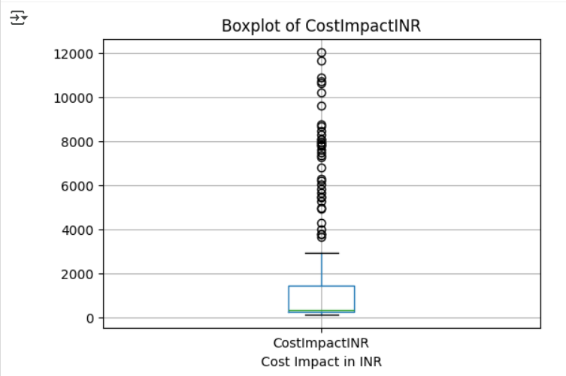
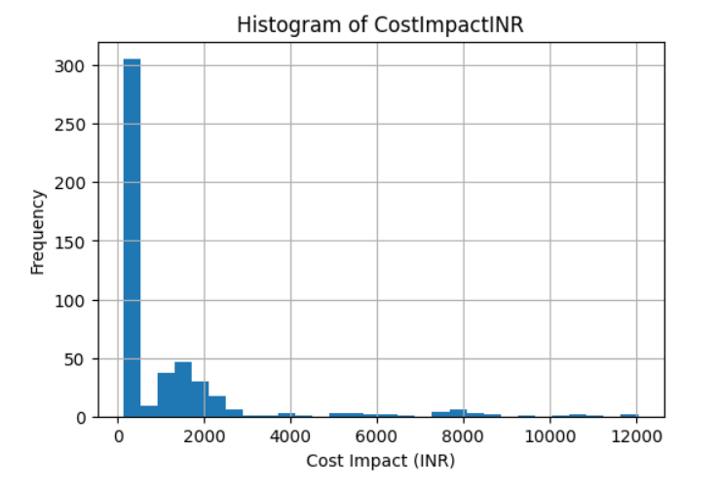
Outlier Visualization
CostImpactINR → heavy right tail → treat using IQR (cap or drop).

Slide 8
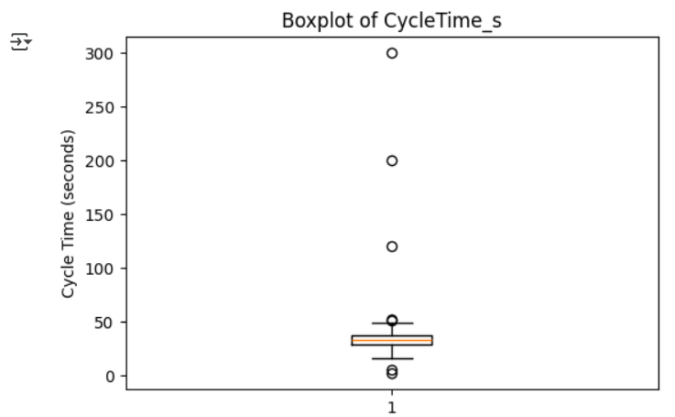
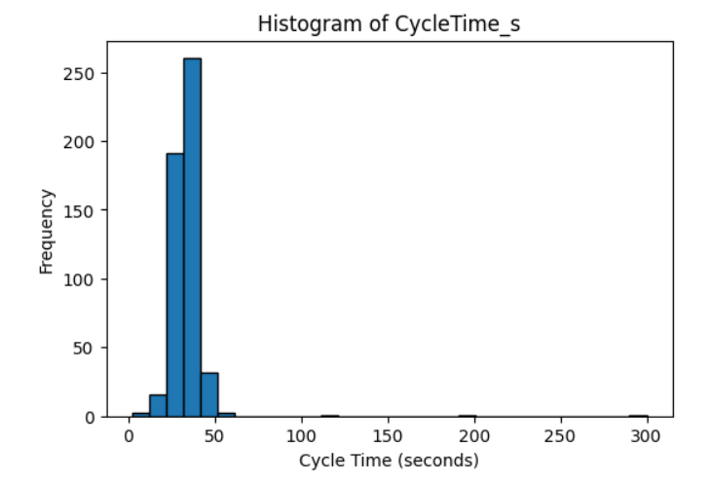
Outlier Visualization
CycleTime_s → spikes >200 → drop or investigate separately.

Slide 9
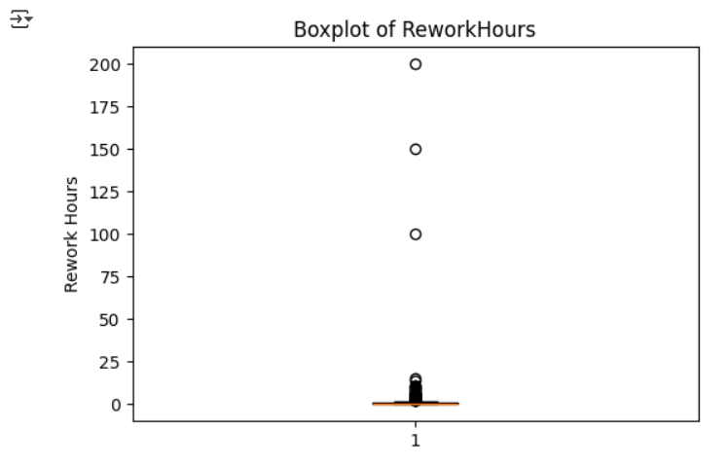
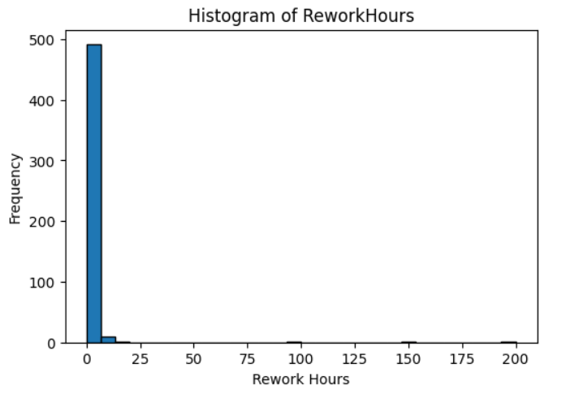
Outlier Visualization
ReworkHours → tail beyond 20 hrs → Winsorize or cap

Slide 10
Key Findings
✅ Missing values are small (fixable).
✅ Duplicates = 4 → drop safely.
✅ Category inconsistency → DefectType needs cleanup.
✅ Numeric columns show skew & outliers → require treatment.
✅ Date range valid (July–Sept 2025).

Slide 11
Cleaning Plan
Drop 4 duplicate rows.
Impute missing values:
DefectType & Material → mode.
CostImpactINR → median grouped by DefectType.
Standardize DefectType labels ("Warp", remove trailing spaces).
Handle outliers:
CostImpactINR & ReworkHours → IQR-based cap.
CycleTime_s outliers >200 → drop/investigate.
Drop unnecessary columns (LotNo).
Save final dataset as defect_data_clean.csv.

Slide 12
Data Cleaning Summary
Removed 4 duplicate rows.
Filled DefectType (11 missing → 2.1%) with mode (“Warp”).
Filled CostImpactINR (20 missing → 3.9%) with median grouped by DefectType.
Filled Material (20 missing → 3.9%) with mode (“ABS”).
Handled outliers:
CostImpactINR capped at 3204 (IQR).
CycleTime_s capped at 200 sec.
ReworkHours capped at 20 hrs.

Slide 13


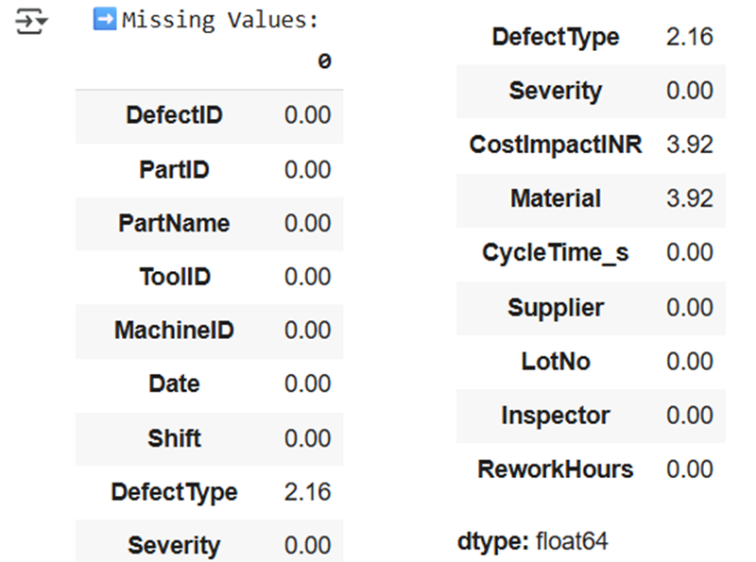
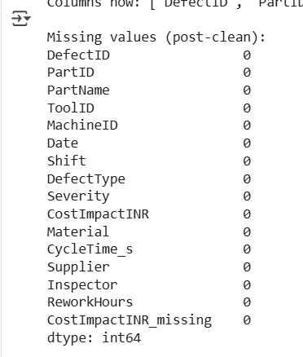
Before vs After Snapshot
BEFORE
AFTER
“Dataset reduced 510 → 505 rows, missing values & outliers fixed.”

Slide 14
Final Deliverable
Final cleaned file: defect_data_clean_v1.csv.
Ready for SQL, Excel pivots, Power BI dashboards.
Total columns: 15 → after dropping LotNo = 14.
Data integrity check passed → no missing values.

Slide 15
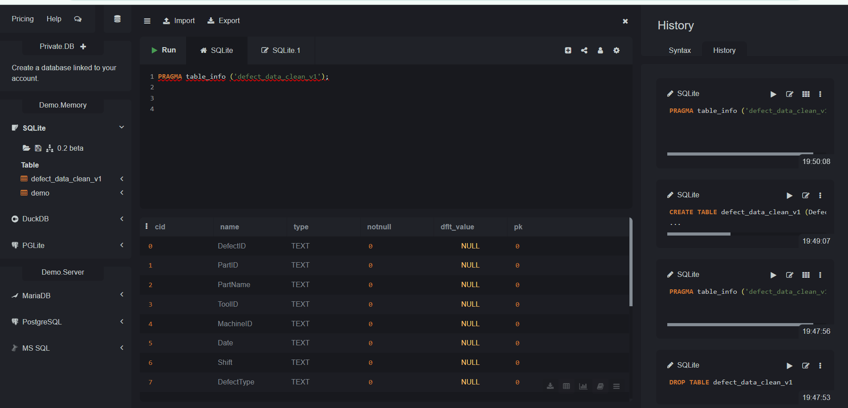
SQL\ ANALYSIS (Data Schema)
Verified that all columns were imported correctly.
Checked column names and data types.

Slide 16
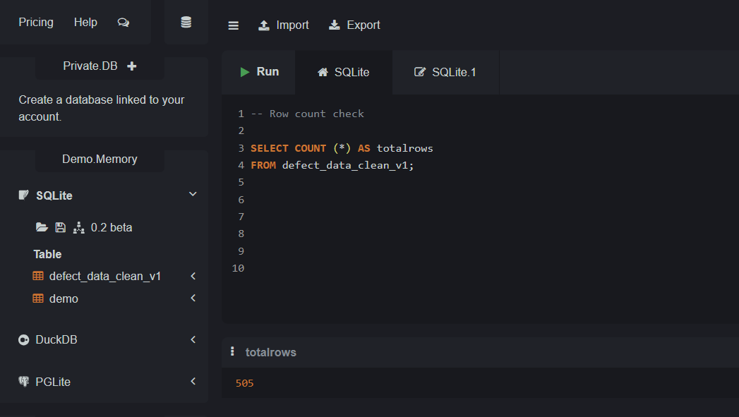
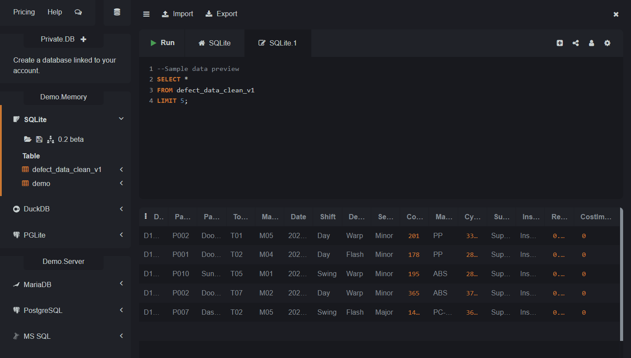
SQL\ ANALYSIS (Row + Sample Data Check)
Verified total records = 505 rows (matches cleaned dataset after Python).
Quick preview confirms expected columns loaded correctly (DefectID, PartID, PartName, Supplier, etc.).
No column misalignment or missing fields during import.

Slide 17
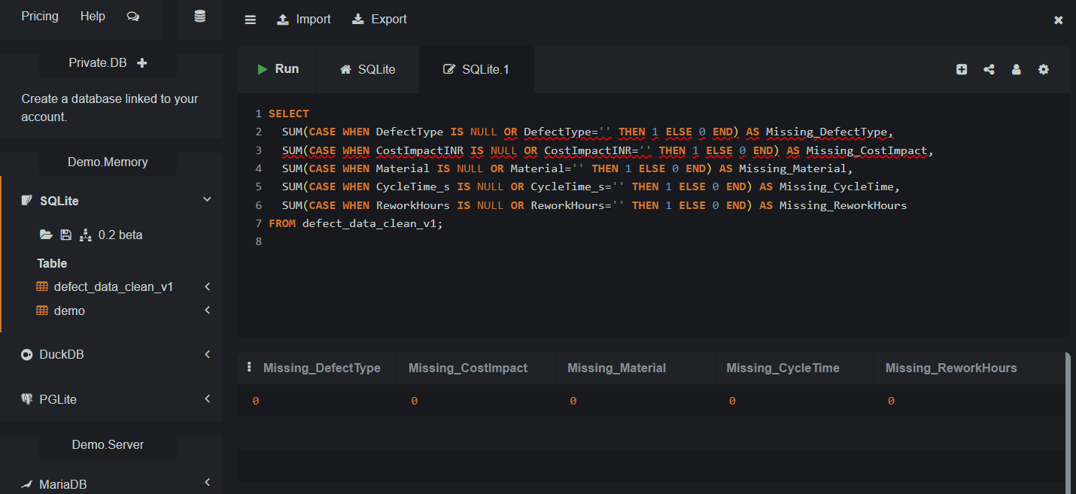
SQL\ ANALYSIS (Missing Values Check)
Verified key columns (DefectType, CostImpactINR, Material, CycleTime_s, ReworkHours) for missing/null values.
Used CASE WHEN … IS NULL OR ='' logic to detect missing data.
Result: 0 missing values in all critical columns ✅
Confirms that cleaning process in Python was effective before importing into SQL.
This ensures no risk of NULL values affecting aggregations (SUM, AVG) or joins in queries.

Slide 18
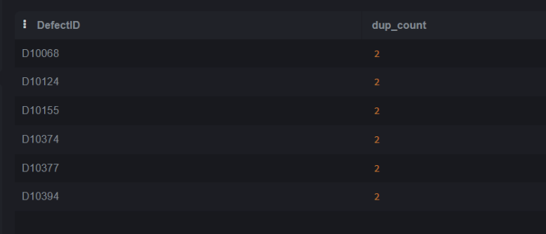
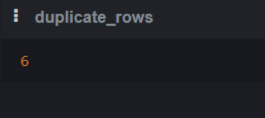
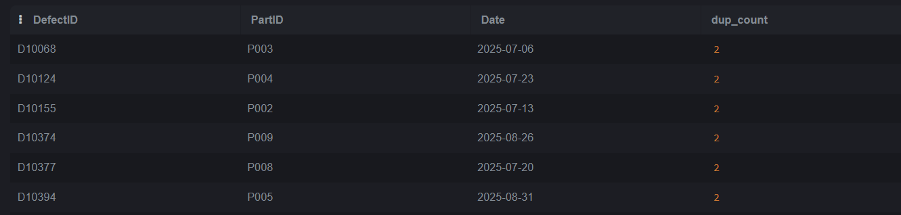
SQL\ ANALYSIS ( Duplicate Check Results)
Findings:
6 exact duplicate rows detected (DefectID + PartID + Date).
Duplicate DefectIDs observed (e.g., D10068, D10124).
Interpretation:
Exact duplicates → likely data entry/system issue.
Repeating IDs with different details → possible conflicting data.
Decision:
Drop 6 exact duplicates → prevents double counting.
Keep 505 → 499 valid rows remain.

Slide 19
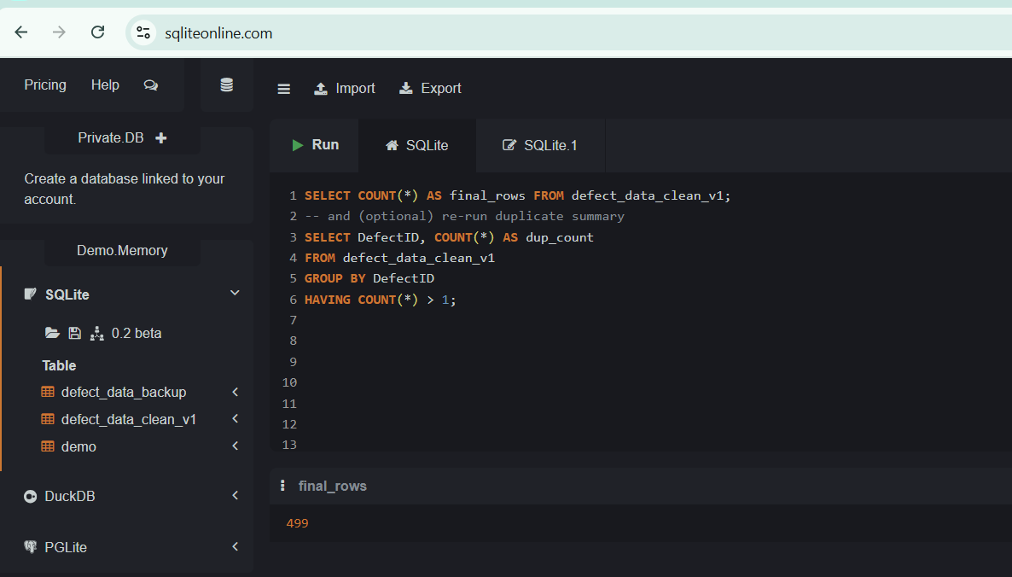
SQL\ ANALYSIS (Duplicate Check Results)
Action: Dropped 6 duplicate rows (505 → 499).
Result: Final cleaned dataset has 499 rows, stored as defect_data_clean_v1.
Backup: defect_data_backup still holds original 505 rows.

Slide 20
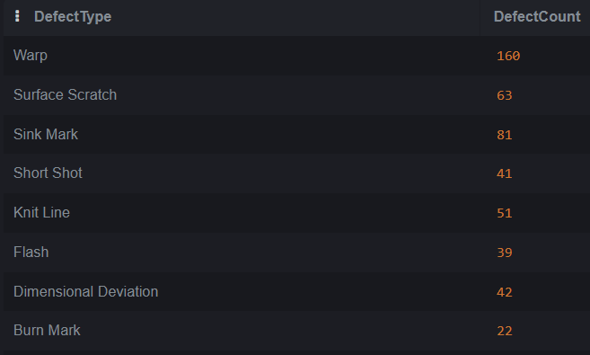
SQL\ ANALYSIS (Defect Frequency by Type)
Findings:
Warp defects = 160 (≈32%) — highest among all defect types.
Sink Mark = 81 and Surface Scratch = 63 are the next common issues.
Together, the top 3 defect types contribute >70% of total defects.
Interpretation:
Defect distribution is highly skewed — a few categories dominate.
Pattern reflects the Pareto principle (80/20 rule) where small set of issues cause most rework.
Indicates process weakness or design tolerance issues mainly in Warp & Sink Mark parts.
Decision / Action:
Focus quality improvement on Warp and Sink Mark first for maximum ROI.
Share these results with production & supplier quality teams to reduce rework hours.
Track monthly reduction trend to confirm improvement impact.

Slide 21
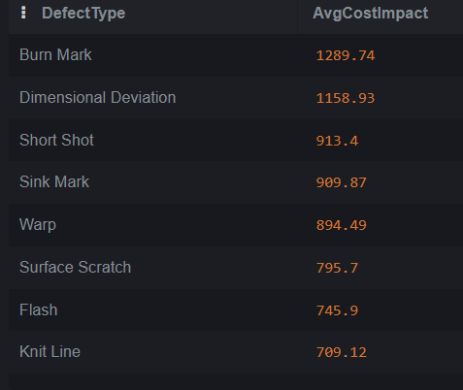
SQL\ ANALYSIS (Average Cost Impact per Defect Type)
Findings:
Burn Mark is the costliest defect type on average (~₹1290/defect).
Dimensional Deviation and Short Shot also show very high average costs (>₹900).
Warp and Sink Mark are frequent defects (seen earlier) but have slightly lower average cost (~₹895–₹910).
Knit Line is the least costly defect on average (~₹709).
Interpretation:
Some rare defects (Burn Mark, Dimensional Deviation) are highly expensive when they occur.
Common but cheaper defects (Warp, Sink Mark) still add up due to frequency.
Highlights the need to attack both high-cost and high-frequency defects differently.
Decision:
Focus engineering resources on Burn Mark & Dimensional Deviation for cost savings.
Monitor Warp & Sink Mark with higher frequency checks since they drive volume.
Build a defect-cost matrix (Frequency vs. Cost) to prioritize corrective actions.

Slide 22
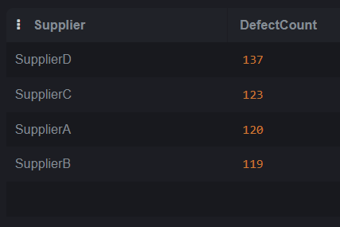
SQL\ ANALYSIS (Which suppliers are contributing the highest number of defects?)
Findings:
Supplier D has the highest defect count (137 defects).
Supplier C (123), Supplier A (120), and Supplier B (119) are also high contributors.
Defects are fairly evenly distributed among top 4 suppliers.
Interpretation:
No single supplier dominates; issue is spread across multiple vendors.
Supplier D requires immediate attention, but Supplier A–C also need review.
Consistent defect levels indicate systemic supplier quality gaps.
Decision:
Launch supplier quality audits starting with Supplier D.
Develop supplier performance scorecards to track defect reduction.
Engage top 4 suppliers in joint root cause analysis and improvement programs.

Slide 23
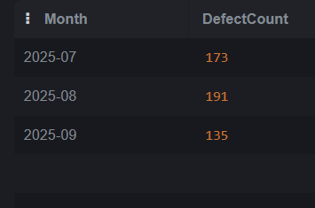
SQL\ ANALYSIS (Monthly Defect Trend (Defect Count by Month)
Findings:
Defect counts vary by month: July (173), August (191), September (135).
August shows peak defects (191) → potential process/seasonal issue.
Decline observed in September (135), but still significant volume.
Interpretation:
Defects are not constant → process stability issue.
Peak in August could be linked to high production load or supplier/material variability.
Trend monitoring is needed monthly to catch spikes early.
Decision / Action:
Conduct root-cause analysis for August spike.
Set up monthly defect monitoring dashboard (Power BI/Excel).
Escalate findings to production team for preventive action.

Slide 24
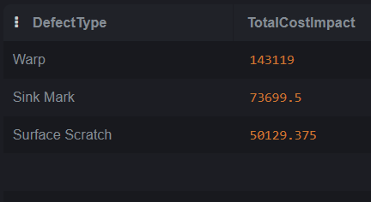
SQL\ ANALYSIS (Top 3 High-Impact Defects (by cost))
Findings:
Warp contributes the highest total cost impact (₹143K+).
Sink Mark is second (₹73K+).
Surface Scratch follows (₹50K+).
Interpretation:
These 3 defect types account for the majority of cost losses.
High-cost impact does not always mean highest frequency — it shows severity of financial loss.
Decision:
Prioritize root-cause analysis and corrective action on Warp, Sink Mark, and Surface Scratch.
Allocate resources (quality checks, supplier audits) to reduce these 3 defects first for maximum ROI.

Slide 25
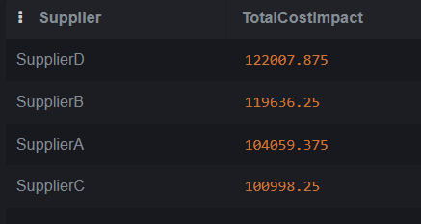
SQL\ ANALYSIS (Supplier-wise Total Cost Impact)
Findings
SupplierD has the highest cost impact at ~122,008 INR.
SupplierB follows closely (~119,636 INR).
SupplierA and SupplierC show lower but still significant contributions (~104k and ~101k INR).
Interpretation
High total cost from SupplierD and SupplierB suggests quality or process inefficiency issues.
Even though SupplierC had fewer defects earlier, the cost per defect might be higher.
Decision
Engage with SupplierD and SupplierB → targeted quality review.
Perform root cause analysis on high-cost defects by supplier.
Use as input for supplier scorecard / negotiations.

Slide 26
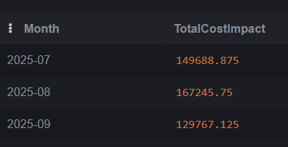
SQL\ ANALYSIS (Monthly Cost Impact Trend)
Findings
July defect cost impact: 149,688 INR
August defect cost impact: 167,245 INR (highest)
September defect cost impact: 129,767 INR (decline observed)
Interpretation
Defect cost peaked in August, possibly due to higher production or severe defect types.
September shows improvement / lower costs, meaning corrective actions might be working.
Decision
Investigate process/production changes in August → find root cause of cost surge.
Continue September corrective measures → ensure consistency.
Track monthly cost trends regularly to identify future spikes early.

Slide 27
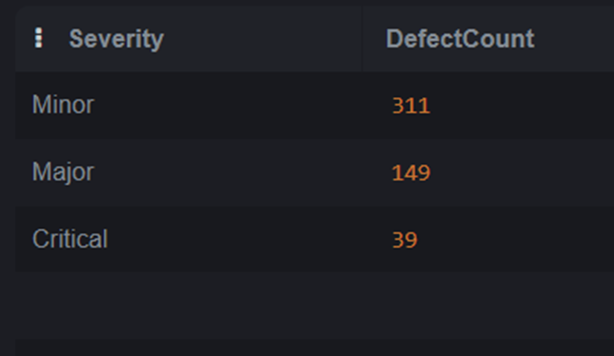
SQL\ ANALYSIS (Defect Distribution by Severity)
Findings:
Most defects are Minor (311).
Major defects are significant at 149.
Critical defects are relatively low (39), but these often have the highest business impact.
Interpretation:
High share of Minor defects → indicates common but low-risk issues.
Major + Critical defects (188 total) need closer monitoring as they may cause rework, delays, or safety concerns.
Decision:
Prioritize Critical defects first for root-cause analysis.
Set up regular review of Major defect trends to avoid escalation.
Track Minor defects in bulk and resolve through process standardization.

Slide 28
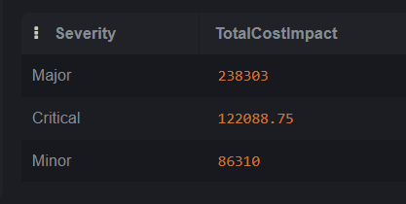
SQL\ ANALYSIS (Cost Impact by Severity)
Findings:
Major defects are the most costly → ₹238,303 total impact.
Critical defects, though fewer in number, still cause ₹122,089 in cost.
Minor defects are high in count but relatively lower cost (₹86,310).
Interpretation:
High cost is not always linked to frequency — severity drives disproportionate impact.
Major issues must be prioritized for cost savings.
Critical issues, while fewer, represent serious risks (quality/safety).
Decision:
Allocate more resources to prevent & fix Major defects (biggest cost burden).
Develop a special escalation process for Critical defects (to avoid risk and future liability).
Continue monitoring Minor defects but with lower resource allocation.

Slide 29
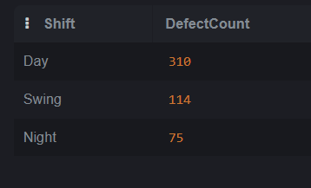
SQL\ ANALYSIS (Defects by Shift)
Findings
Day shift has the highest defects (310).
Swing shift shows moderate defects (114).
Night shift has the lowest defects (75).
Interpretation
Higher day shift defects may be due to higher production volume during the day.
Swing shift defects could indicate transition/hand-over issues.
Night shift may benefit from slower pace or fewer production runs, leading to fewer defects.
Decision
Investigate why Day shift has higher defects → check workload, operator fatigue, or machine usage.
Standardize shift-to-shift process handovers.
Balance production scheduling across shifts to reduce concentration of defects.

Slide 30
SQL\ ANALYSIS (Final Summary – SQL Analysis Insights)
Warp defects & Supplier D are the top contributors to quality issues.
August recorded the highest defect count and cost impact.
Major severity defects drive the largest costs; Critical defects carry high risk despite lower frequency.
Day shift has significantly higher defects → indicates production imbalance.
Supplier cost analysis highlights Supplier D & B as urgent focus areas.
Overall: Improvements should target high-cost defects, key suppliers, and shift-level process balancing.

Slide 31
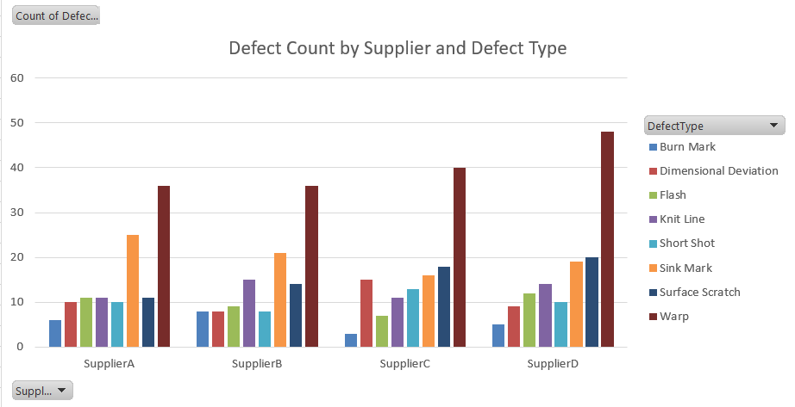
Excel Pivot Insights (Supplier vs Defect Type)
Supplier D has most defects (137), Warp dominates (32%).

Slide 32
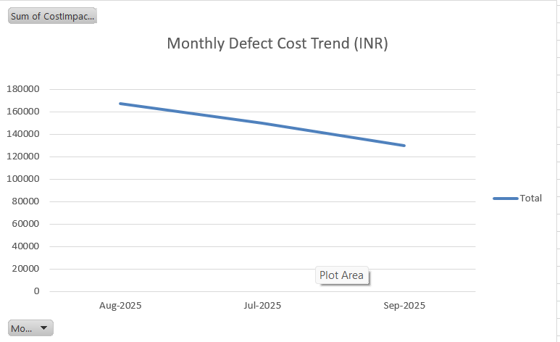
Excel Pivot Insights (Monthly Cost Trend)
August shows peak cost ₹167K, decline in September

Slide 33
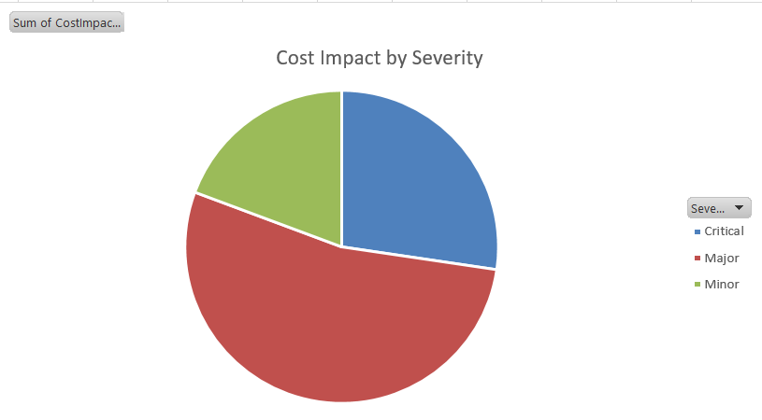
Excel Pivot Insights (Cost Impact by Severity)
Major defects = biggest financial burden (₹238K, ~53%).

Slide 34
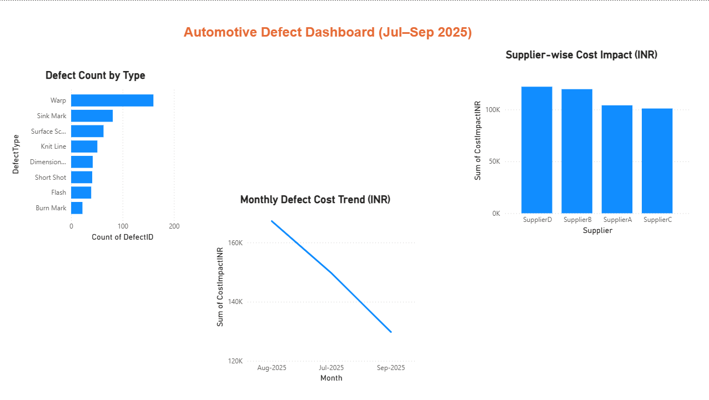
Dashboard Overview (Automotive Defect Dashboard (Jul–Sep 2025))
Interactive Power BI dashboard built using cleaned defect dataset.
Shows defect frequency, supplier cost impact, and monthly trend.

Slide 35
Key Insights(Key Insights from Dashboard)
Warp defects are highest (~160 cases) → main rework cause.
Supplier D shows the highest cost impact (~₹122 K).
Total cost impact ≈ ₹446 K (Jul–Sep 2025).
Monthly trend ↓ Aug → Sep → quality improvement visible.

Slide 36
Recommendations
Focus corrective actions on Warp & Sink Mark defects.
Work with Supplier D on process audits and mold maintenance.
Maintain current inspection plan—trend shows cost reduction.
Use dashboard for weekly supplier review meetings.

